Slide 1
Innovate with Azure AI AI Powered Anomaly Detection for IoT
Powered by Azure AI engineering Team
Dave Glover | Cloud Advocate | Sydney Australia | T: @dglover |

Slide 2
Agenda
1
Azure Anomaly Detection Overview
IoT Anomaly Detection Demos
Resources
Q&A
2
Notes:
In today’s conversation, we’ll talk about AI Powered Anomaly Detection for Industrial IoT

Slide 3


Key User Scenarios
AIOps
Examines data in near-real time and pinpoints the minute something happens, spot unusual behavior in deep data layers and shows the key drivers of the problem with root-cause analysis.
Predictive maintenance
Analyze streaming data from equipment sensors and asset management systems to detect anomalies and predict malfunctions before they occur.
Access a new network to an Azure SQL Database
Power plant core temperature exceeds the allowed limit
Notes:
Jinrui
If you want to detect a CPU spike purely based on CPU data, use our product.
If you have an expensive physical asset like aircraft, an oil rig, or a satellite. Each of these assets has tens or hundreds of different types of sensors. You would have to look at all those time series signals from those sensors to decide whether there is system level issue.
AIOps (Artificial Intelligence for IT Operations)
AIOps combines big data and machine learning to automate IT operations processes, including event correlation, anomaly detection and causality determination.

Slide 4
Product Overview
IoT Univariate Anomaly Detection Demo
IoT Multivariate Anomaly Detection Demo
Q & A
Notes:
Dave to take from here…
Made up of two services
Univariate and Multivariate
Enables developers to deeply integrate machine learning models into applications and business processes without having to be Machine Learning experts
When to use Univariate
The Anomaly Detector enables you to monitor and detect abnormalities in your time series data without having to know machine learning.
Algorithms adapt by automatically identifying and applying the best-fitting models to your data, regardless of industry, scenario, or data volume.
Real-time
Detects anomalies in your data stream using previous seen data
A model is generated using the data to determine if the last data is an anomaly
Batch
Model built from entire batch of data to determine anomalies
For example, you want to detect daily revenue anomalies based on revenue data itself, or you want to detect a CPU spike purely based on CPU data, a spike in temperature based on temperature data
The univariate service can also be containerized

Slide 5
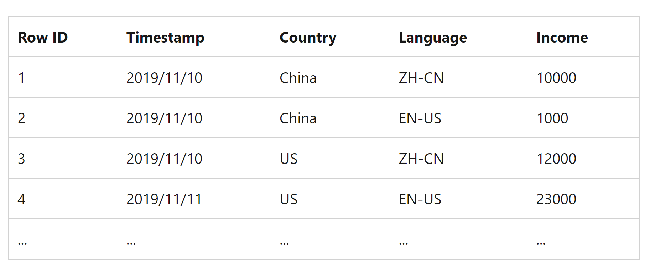
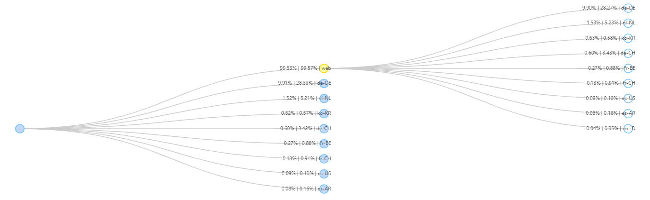
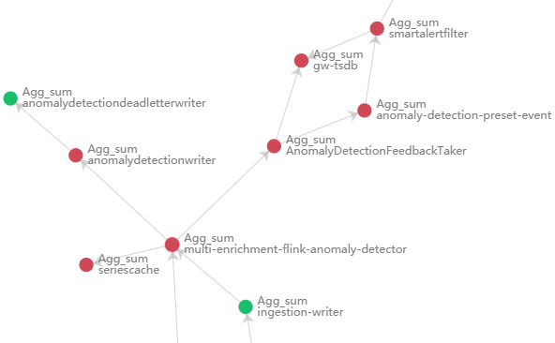



Product 1- Univariate anomaly detection
When to use univariate?
Sample data
Univariate Anomaly Detection
Univariate Anomaly Detection Product Flow
Take time series as input
Auto model selection and inference
Return anomaly related metadata (is Anomaly, range of expected value…)
Common scenarios: Business Ops, AIOps, Root cause analysis …
Notes:
Dave to take from here…
It’s AI that detects problems before systems or customers are impacted – a very common use case is predictive maintenance
Enables developers to deeply integrate machine learning models into applications and business processes without having to be Machine Learning experts
When to use Univariate
The Anomaly Detector enables you to monitor and detect abnormalities in your time series data without having to know machine learning.
Algorithms adapt by automatically identifying and applying the best-fitting models to your data, regardless of industry, scenario, or data volume.
Real-time
Detects anomalies in your data stream using previous seen data
A model is generated using the data to determine if the last data is an anomaly
Batch
Model built from entire batch of data to determine anomalies
For example, you want to detect daily revenue anomalies based on revenue data itself, or you want to detect a CPU spike purely based on CPU data, a spike in temperature based on temperature data
The univariate service can also be containerized
Unsupervised SR-CNN

Slide 6
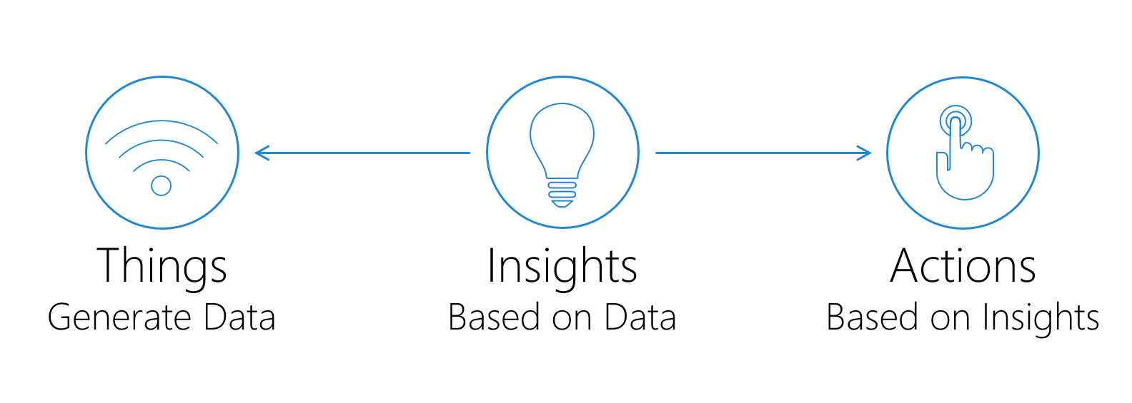
Architecture of an IoT Anomaly detection solution
Notes:
At a high level the architecture of an IoT solution is made up three components
Firstly, we have Things which generate data – For example devices monitoring the temperature in a factory, or the manufacturing process
Next, we have Insights which are built on the data generated from the Things
Finally, we have Actions, which are based on the Insights – For example we may want to turn off the heating and lighting if there’s no one in the building, or perhaps we want to notify a maintenance center when a machine requires attention.

Slide 7
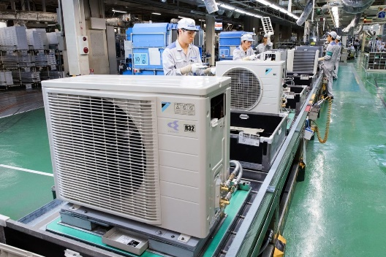
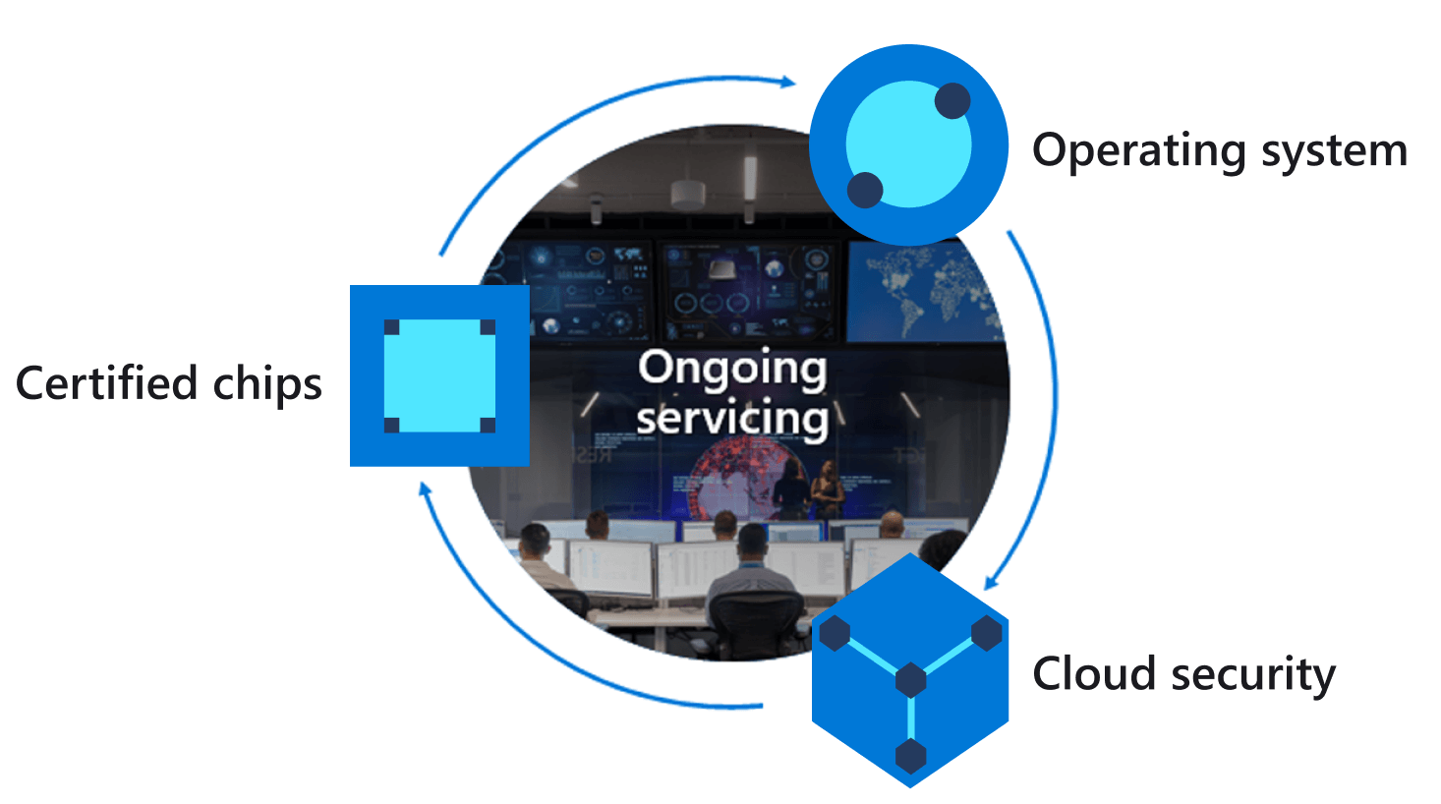


IoT Information Flow
Visualize data
and learnings
Edge Devices
Intelligent
Edge
Jupyter
Notebook
Edge Devices
Configure and control
Stream processing and
transformation
IoT Central
IoT Central
Data Export
Business Integration
Azure Anomaly Detector
Service
Warm Path store
Cold Path store
Storage
Things
Insights
Actions
Notes:
Now that we’ve gathered Insights let’s finishing up by talking about Actions
<Click>
We’ll want to take the results of our insights and feed them into our Business Processes so we can make better decisions or automate device interaction.
<Click>
We might also consider using the IoT data we collect to build Machine Learning models that can be deployed out to Intelligent Edge devices
What we can see here is a typical IoT Architecture and how the data flows through the system… This is often referred to as the IoT Reference Architecture.

Slide 8
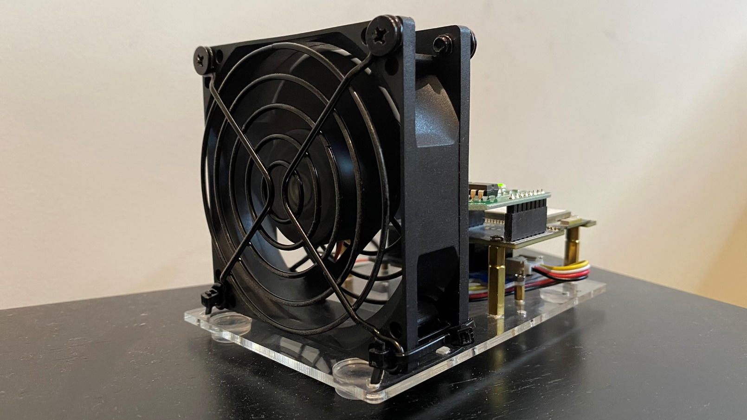
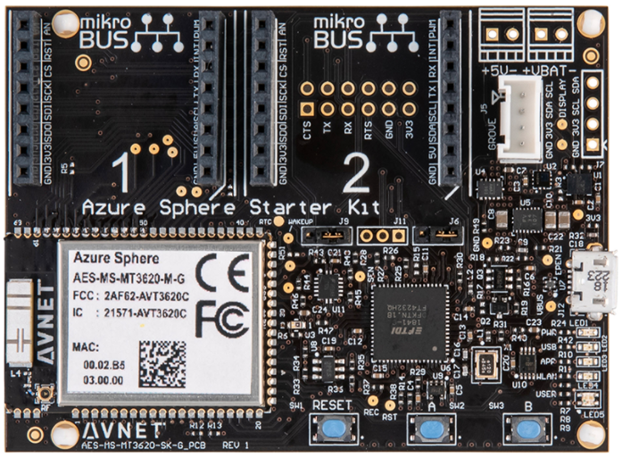
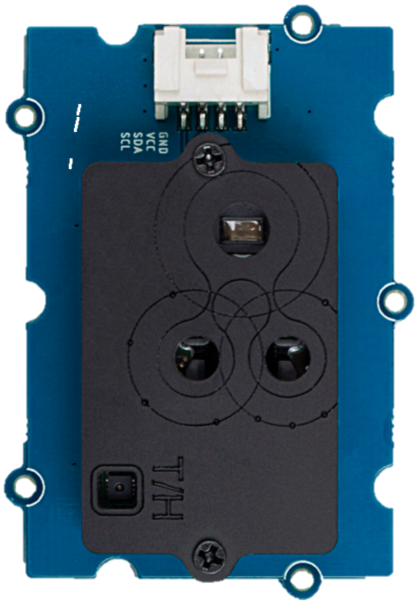
HVAC Azure Sphere Prototype
https://www.microsoft.com/research/wp-content/uploads/2017/03/SevenPropertiesofHighlySecureDevices.pdf

Slide 9
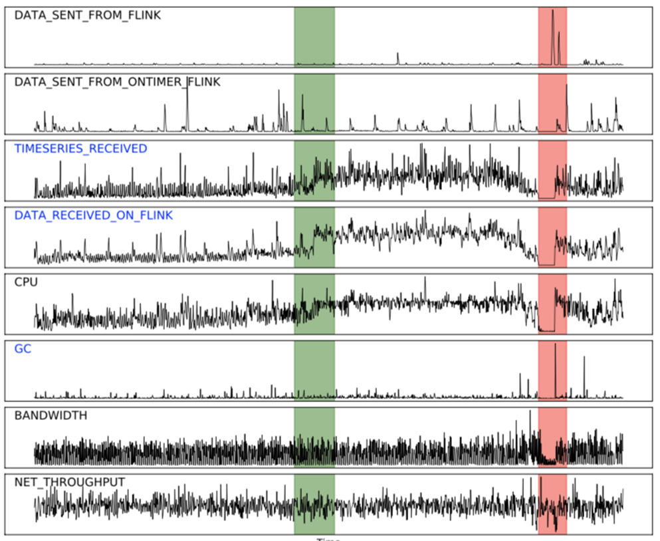


Powered by AI on the Edge and the Cloud
Secure Intelligent Edge
Azure Sphere with Edge Impulse
Secure Intelligent Cloud
Azure Anomaly Detector
Univariate & Multivariate
Low latency, low power, partially connected
+
Notes:
The solution takes advantage of AI on the Edge and AI in the Cloud
Edge Impulse bringing Tensorflow Lite (known as embedded machine learning, or TinyML)
Target audience is developers – so you don’t need to be a machine learning data scientist
Edge Impulse
End to end device to cloud
Integration with backend services
IoT Hub/Central routing, Logic Apps, Teams

Slide 10
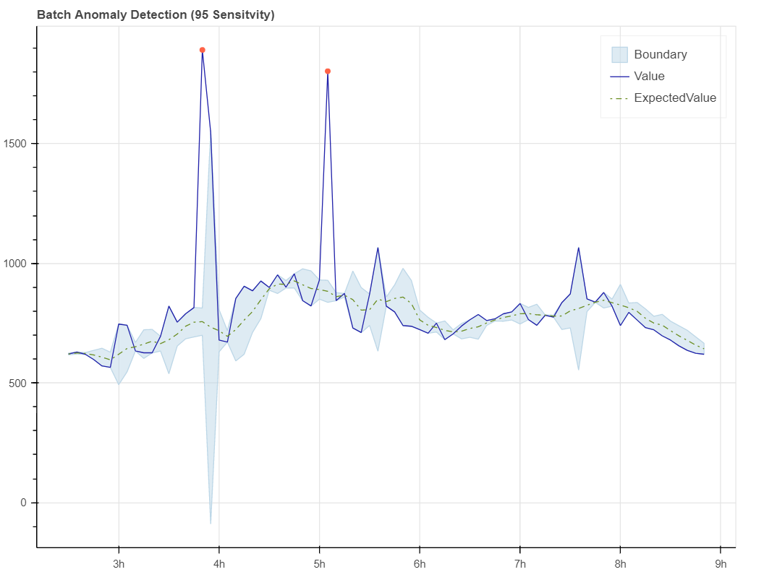
Univariant Anomaly Detection
Edge Impulse
Azure IoT Central
Azure Sphere Movement Classification
Data Export
Jupyter Notebook Analysis
Notes:
Azure Anomaly Detector Service

Slide 11
Product Overview
IoT Univariate Anomaly Detection Demo
IoT Multivariate Anomaly Detection Demo
Q & A
Notes:
Hand back

Slide 12
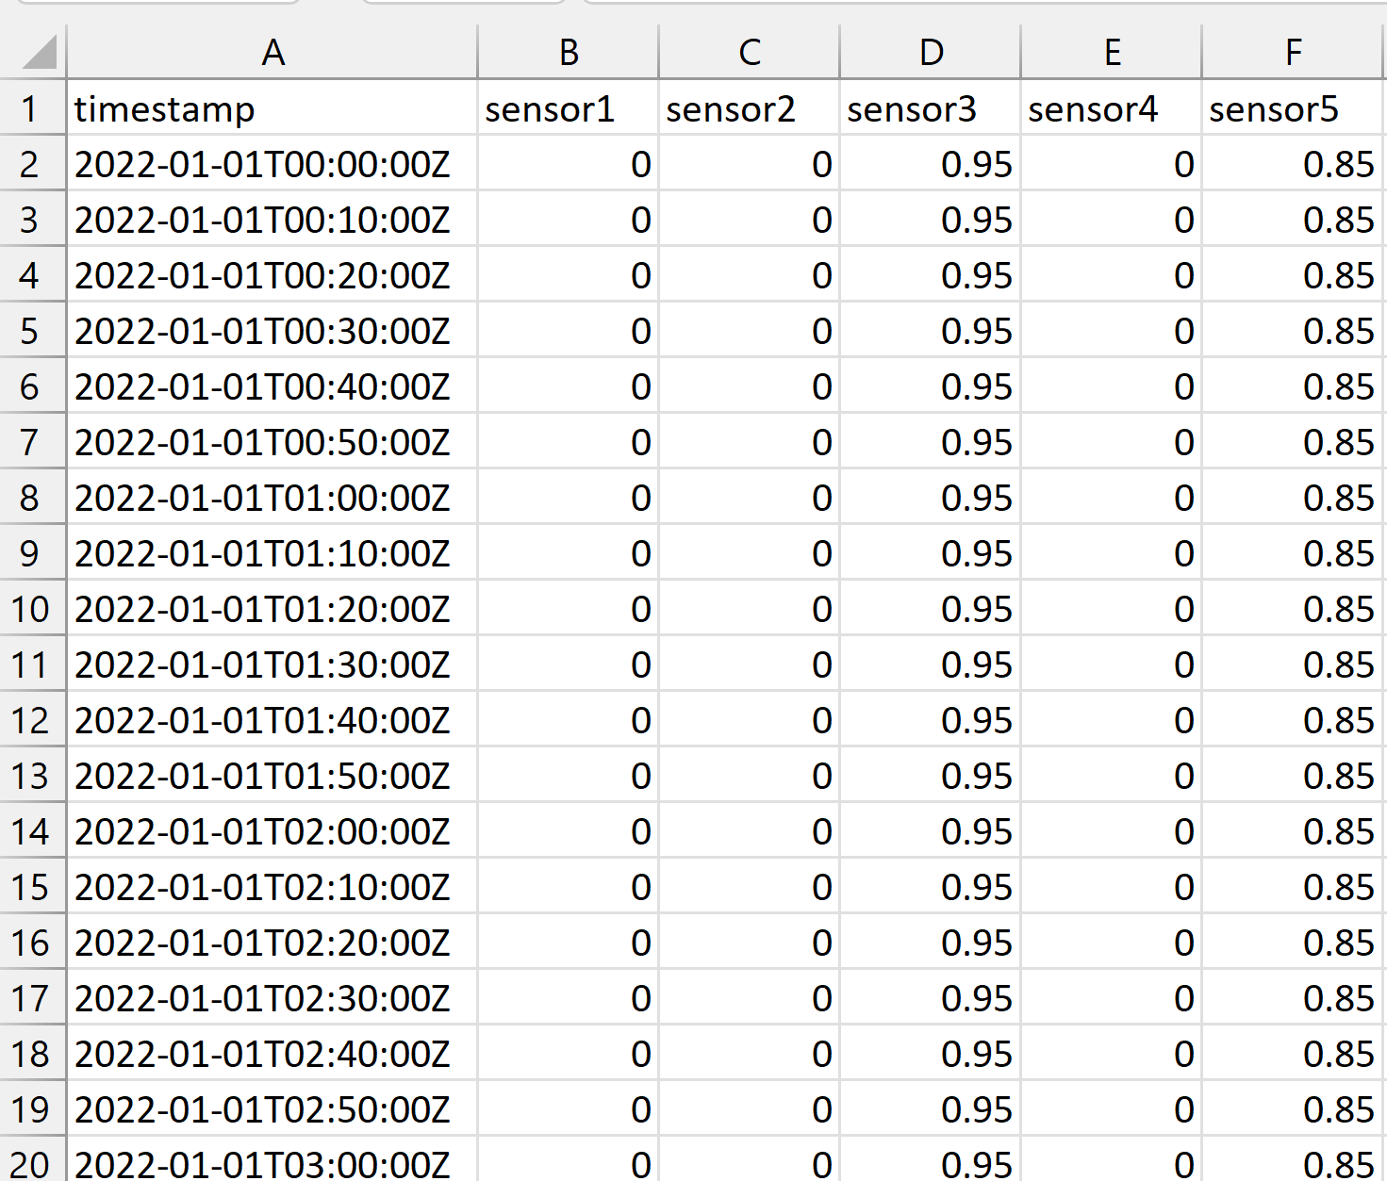
Product 2- Multivariate anomaly detection
When to use multivariate?
Multivariate (up to 300 sensors)
Anomaly Detection
Sample data
Common scenarios: Equipment health, IoT, Energy…
Notes:
Multivariate when to use
Identify multivariate anomalies
Use multivariate anomaly detection to evaluate multiple signals and the correlations between them to find sudden changes in data patterns before they affect your business.
Enables developers to deeply integrate machine learning models into applications and business processes without having to be Machine Learning experts
Detect system level anomalies from a group of correlated time series data with multivariate anomaly detection APIs.
Dependencies and inter-correlations between up to 300 different signals are now automatically counted as key factors.
Useful when any individual time series won't tell you much.
For example, you have an expensive physical asset like business metrics, an aircraft, equipment on an oil rig, a factory, or a satellite with multiple 10 or 100s of sensors
You can use the multivariate service and all those data signals to determine if there is system level issue. You can use to proactively predict the likelihood of a serious failure
The new multivariate anomaly detection APIs further enable developers by easily integrating advanced AI for detecting anomalies from groups of metrics, without the need for machine learning knowledge or labeled data.
The new multivariate anomaly detection further enable developers by easily integrating advanced AI for detecting anomalies from groups of metrics, without the need for machine learning knowledge or labeled data. Dependencies and inter-correlations between up to 300 different signals are now automatically counted as key factors. This new capability helps you to proactively protect your complex systems such as software applications, servers, factory machines, spacecraft, or even your business, from failures.
Batch and real time: using your entire time series data; detect anomalies in your streaming data by using previously seen data points to determine if your latest one is an anomaly.
Identify multivariate anomalies
Use multivariate anomaly detection to evaluate multiple signals and the correlations between them to find sudden changes in data patterns before they affect your business.

Slide 13
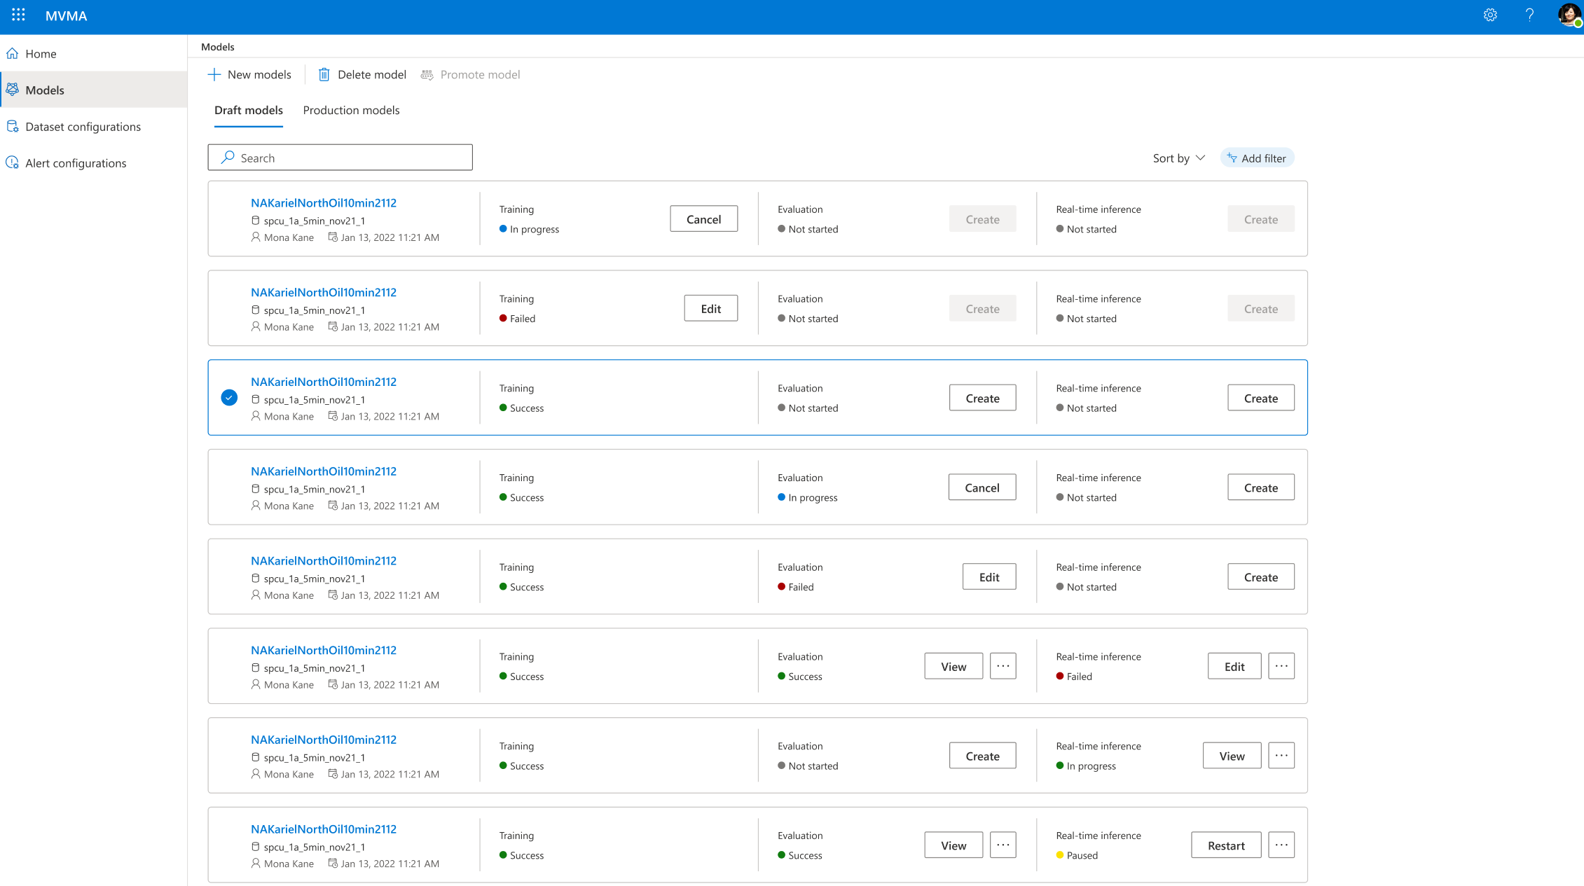






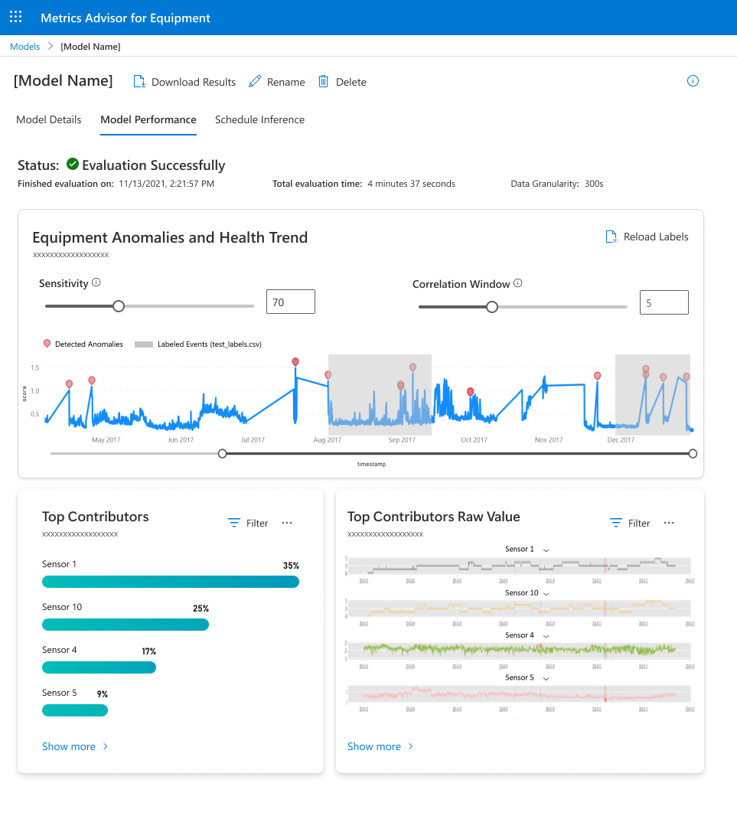






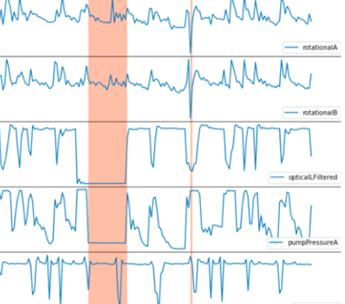



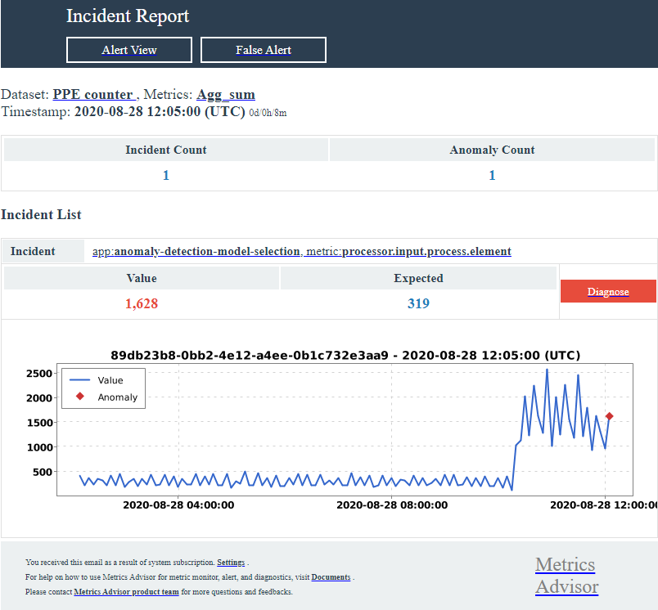
Product Flow - multivariate anomaly detection
Collect data from multiple sources
Build & train adaptive ML models
ML Models: SOTA model for equipment health, easy for training, model management of equipment
Visualize, diagnose, and root cause analysis
Scalable: scale to support various data sources model training and inferencing.
Accurate & Explainable: Holistic view on multivariate data, dependencies and correlations between signals have now been accounted.
Real time: predict and analyze anomalies in real-time based on streaming sensor data
Detect & validate anomalies in real-time
Fine-tune model & configure alerts
Notes:
Training
Train with normal operations data
Inference:
Batch validation, use the asynchronous API.
Streaming with short granularity to get the inference result immediately use the synchronous API.

Slide 14
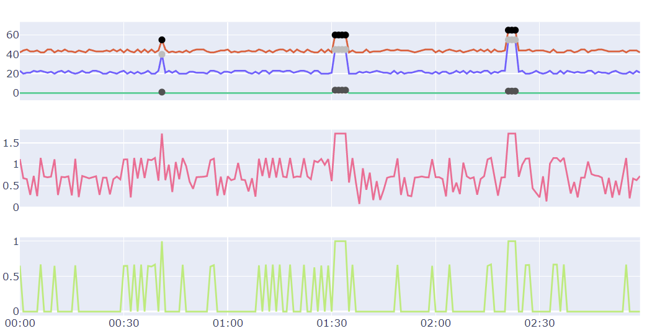
Multivariant Anomaly Detection
Edge Impulse
Azure IoT Central
Data Export
Jupyter Notebook Analysis (Univariate)
Notes:
Jinrui
Our team has two layer of offerings, Content will include basic APIs and end to end UI product. The blue layer is core API service, the orange layer is an applied AI product.
If your goal is to detect individual level anomaly, for example, you want to detect daily revenue anomalies based on revenue data itself, or you want to detect a CPU spike purely based on CPU data, use our univariate anomaly detector.
However, If your goal is to detect system level anomalies from a group of time series data, use multivariate anomaly detection APIs. Particularly, when any individual time series won't tell you much, and you have to look at all signals (a group of time series) holistically to determine a system level issue.
For example, you have an expensive physical asset like aircraft, equipment on an oil rig, or a satellite. Each of these assets has tens or hundreds of different types of sensors. You would have to look at all those time series signals from those sensors to decide whether there is system level issue.

Slide 15
Best Practices
Data prep is key!
Resample if needed
Univariate
Batch: Sessional or flat trend with occasional spikes
Real-time: recommend detecting the anomaly status of your latest data point only
Multivariate needs to learn from normal operations
Sliding window
If the data is periodic, eg weekly, hourly – set length to 1-3 cycles
If data changes rapidly, then helpful to have a longer sliding window - ideally covering a pattern
If the data doesn't change much, then a smaller window is good - reduces processing time eg 50
A larger sliding window may cause longer training/inference time
https://docs.microsoft.com/azure/cognitive-services/anomaly-detector/concepts/anomaly-detection-best-practices
Notes:
Jinrui
Our team has two layer of offerings, Content will include basic APIs and end to end UI product. The blue layer is core API service, the orange layer is an applied AI product.
If your goal is to detect individual level anomaly, for example, you want to detect daily revenue anomalies based on revenue data itself, or you want to detect a CPU spike purely based on CPU data, use our univariate anomaly detector.
However, If your goal is to detect system level anomalies from a group of time series data, use multivariate anomaly detection APIs. Particularly, when any individual time series won't tell you much, and you have to look at all signals (a group of time series) holistically to determine a system level issue.
For example, you have an expensive physical asset like aircraft, equipment on an oil rig, or a satellite. Each of these assets has tens or hundreds of different types of sensors. You would have to look at all those time series signals from those sensors to decide whether there is system level issue.

Slide 16
Product Overview
IoT Univariate Anomaly Detection Demo
IoT Multivariate Anomaly Detection Demo
Q & A
Notes:
Hand back

Slide 17
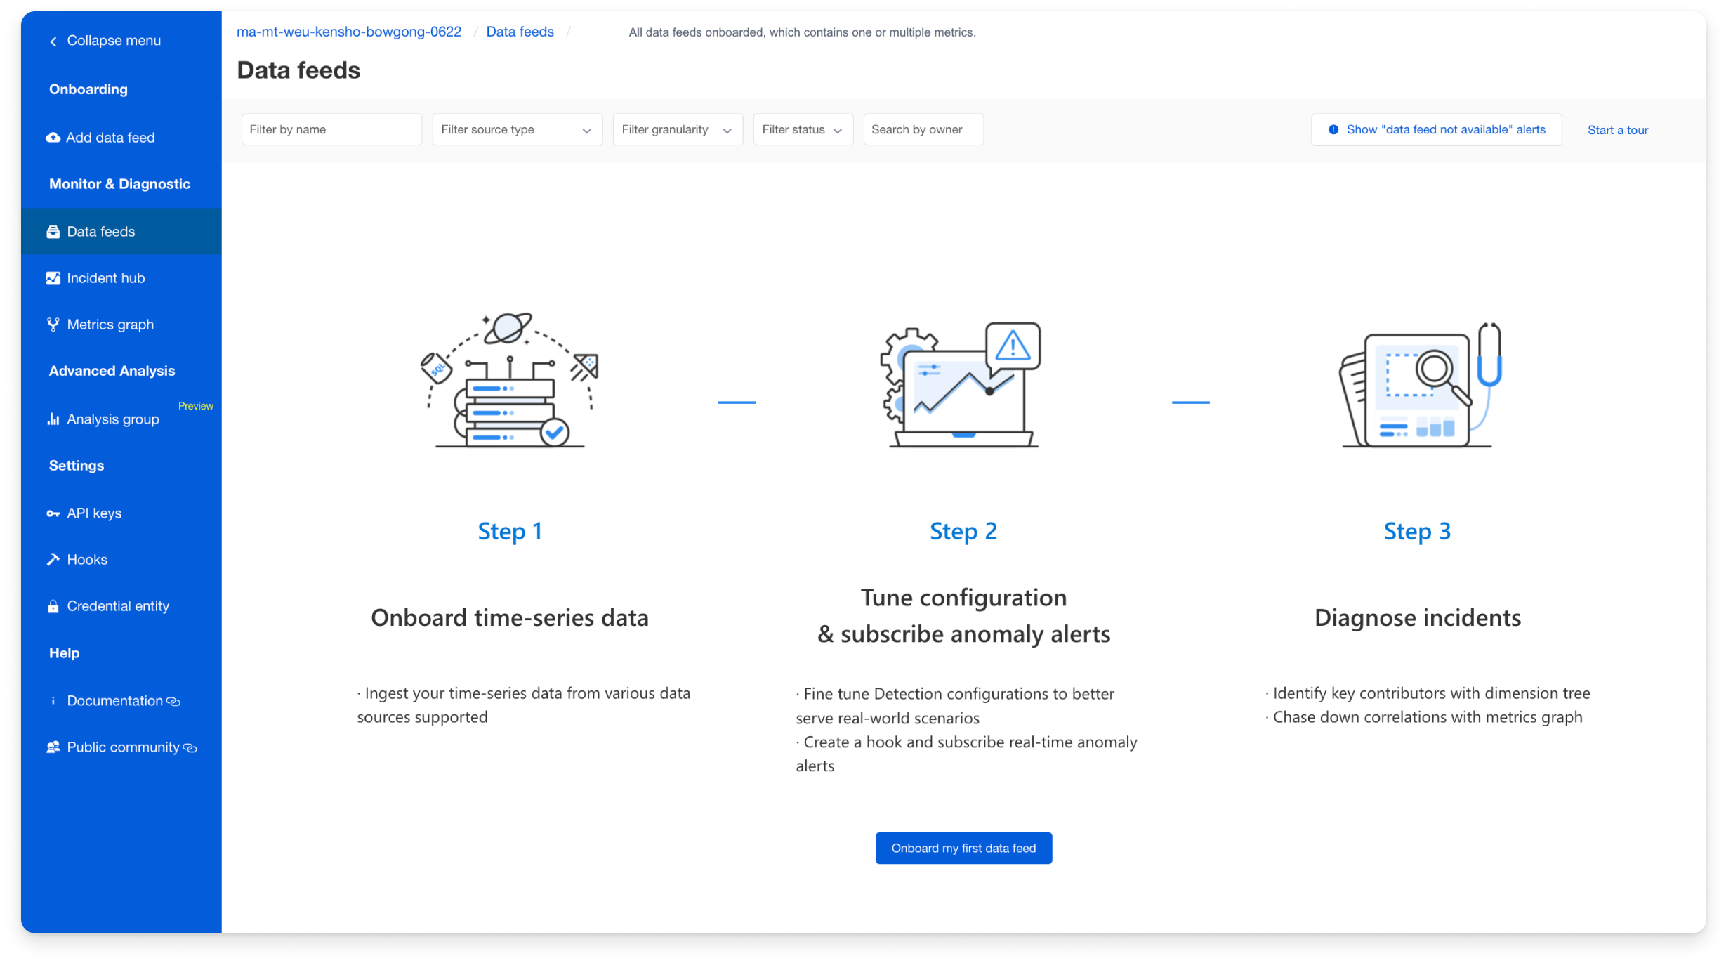
Azure Metrics Advisor built on Anomaly Detector APIs
Metrics Advisor (GA)
Anomaly Detector (API Services)
Univariate Anomaly Detector (GA)
Multivariate Anomaly Detector (Public Preview)
Tabular data Anomaly Detector (Incubation)
Notes:
Jinrui
Our team has two layer of offerings, content will include basic APIs and end to end UI product.
The bottom layer is core API service, the upper layer is our applied AI product.
MA is built on top of Univariate Anomaly detector, and MA for equipment is built on top of Multivariate anomaly detector.
Based on the different scenarios, If your goal is to detect individual level anomaly, for example, you want to detect daily revenue anomalies based on revenue data itself, or you want to detect a CPU spike purely based on CPU data, use our univariate anomaly detector.
However, If your goal is to detect system level anomalies from a group of time series data, use multivariate anomaly detection APIs. Particularly, when any individual time series won't tell you much, and you have to look at all signals (a group of time series) holistically to determine a system level issue.

Slide 18
Resources
Azure Anomaly Detector
https://azure.microsoft.com/services/cognitive-services/anomaly-detector
Azure Metrics Advisor
https://azure.microsoft.com/en-us/services/metrics-advisor
Azure IoT Central
https://azure.microsoft.com/services/iot-central
Edge Impulse
https://www.edgeimpulse.com/
Azure Sphere
https://azure.microsoft.com/services/azure-sphere
Demos
https://github.com/gloveboxes/AzureSphereMLPredictiveMaintenanceHybrid

Slide 19
Thank you
Thank you

